Slide 1

The Use of
Artificial Intelligence in Wildlife Conservation
Kirsty Anderson

Slide 2
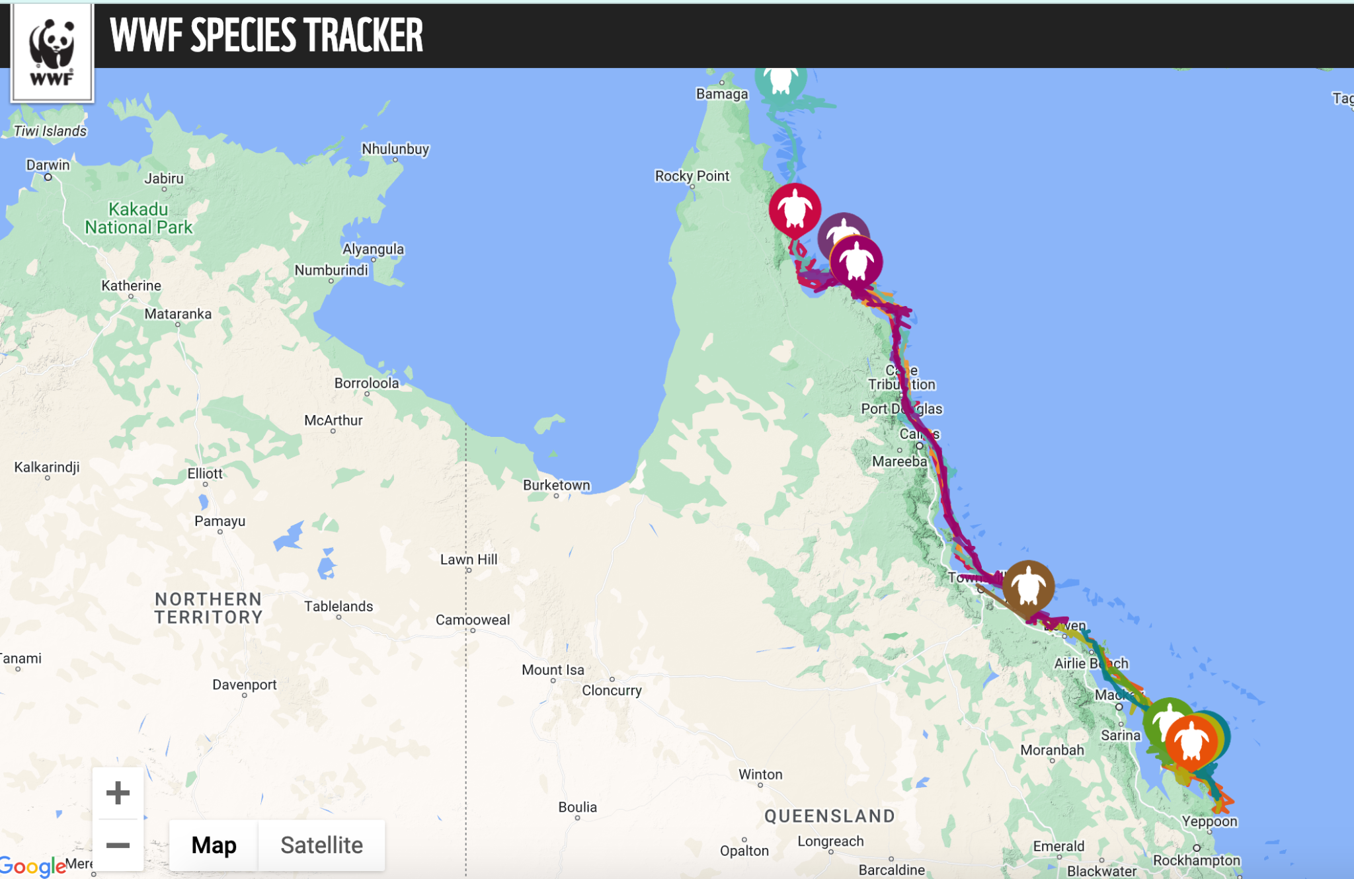
How is data captured from wildlife?
The most common method is to physically attach a tracking device to the studied animal
Like a smart watch, the device will track GPS as well as monitor health statistics
They are very informative devices, and have provided invaluable data to wildlife studies
…but these devices come with the cost of unethical data
Source: http://wwf-ap.org

Slide 3
Why is this data unethical?
The trackers are attached while the animal is tranquilised
Studies have shown that this procedure can cause stress to the animal
If they are a pack animal, they could lose their pack while they are unconscious
Studies have also shown that the attachment of the tracker can hinder movements such as swimming
Source: https://hakaimagazine.com

Slide 4
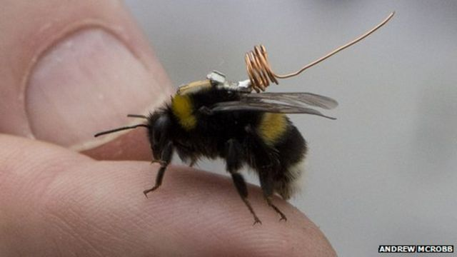
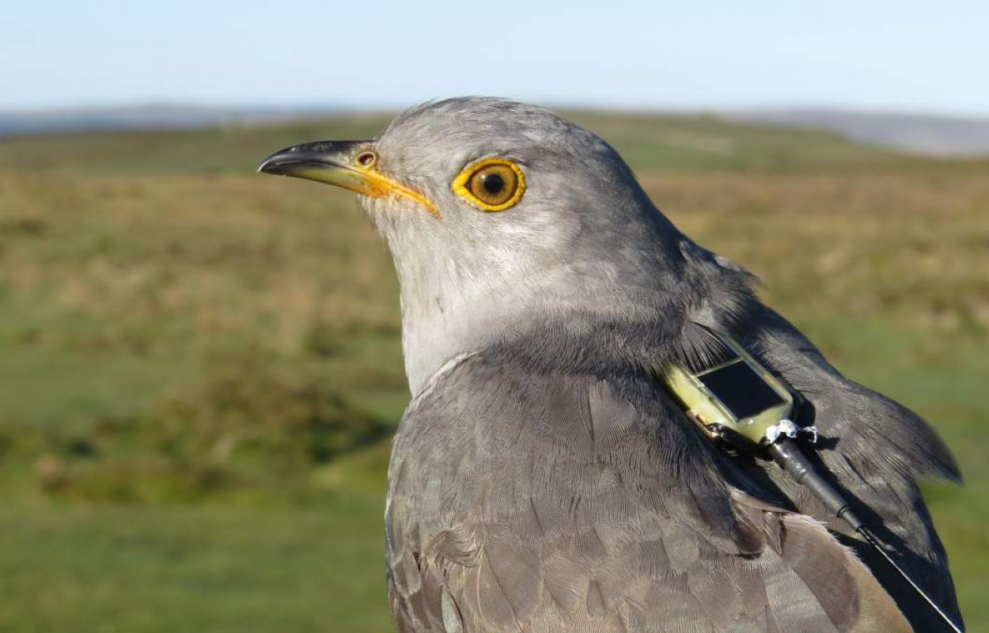
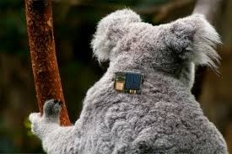
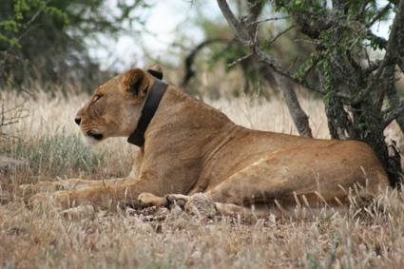
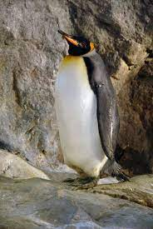
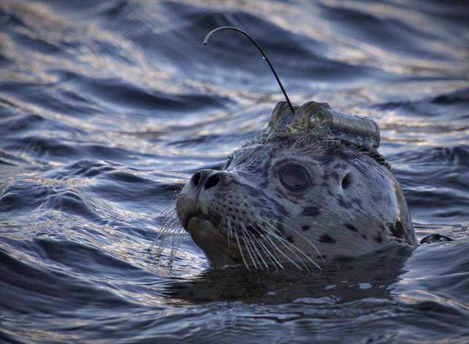
What do the trackers look like?

Slide 5
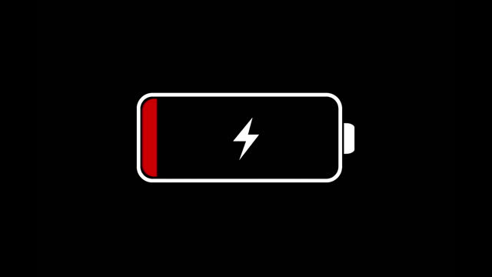
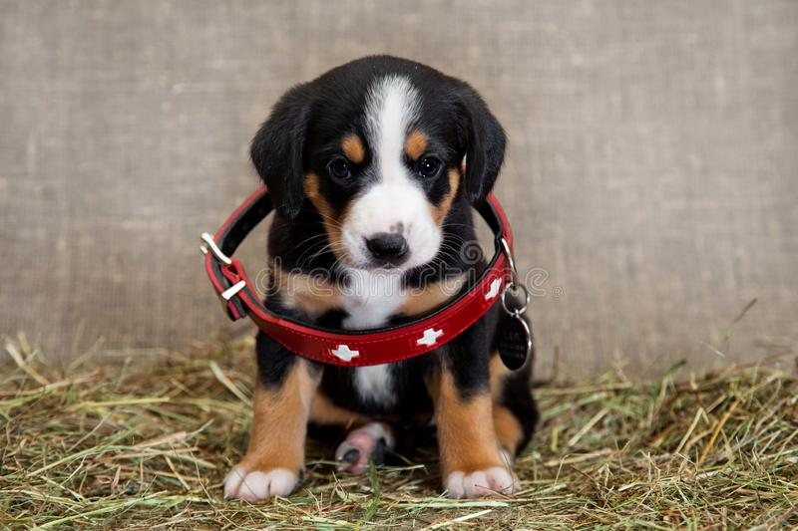
What about the tracker’s longevity?
Outwith the harm to the animal, the data could be completely lost if the tracker is damaged or runs out of battery
The trackers are expensive, and can only really be reused on species of similar size. Most studies would need a broad range of animal data!
It’s intrusive - let nature speak for itself. Us intervening could corrupt the data as the animal is then behaving differently!
Sources: https://defenders.org; www.telemetrysolutions.com

Slide 6

Enter… AI

Slide 7
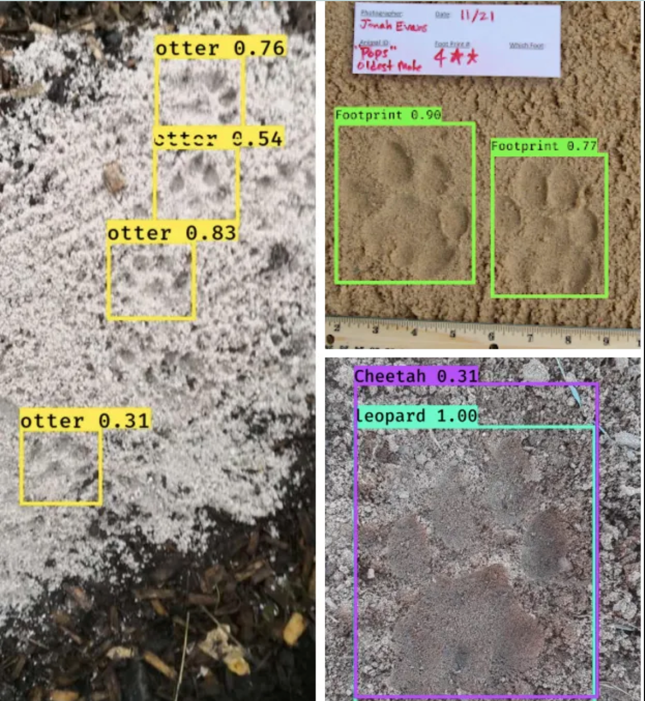
Artificial Intelligence is providing a non-invasive angle for studying wildlife
Tracing footprints
WildTrackAI
This AI was built using machine learning techniques to determine species from images of footprints
Their AI models can provide >90% accuracy in classifying species, and also individual, gender and age group.
Anyone with a smartphone can add to their database by uploading a photo of animal tracks!
Sources: https://www.wildtrack.org/#
https://medium.com/

Slide 8
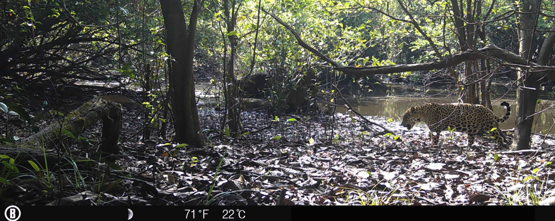
Artificial Intelligence is providing a new angle for studying wildlife
Camera Traps + Species Recognition
WildLife Insights
Camera traps have been in use for some time, but identifying wildlife is a time consuming process
WildLife Insights have created an AI model that is able to identify up to 1295 species as well as filter out media with no animals
There are also AI models that can recognise species’ using sound recordings.
Sources:
https://www.wildlifeinsights.org/

Slide 9
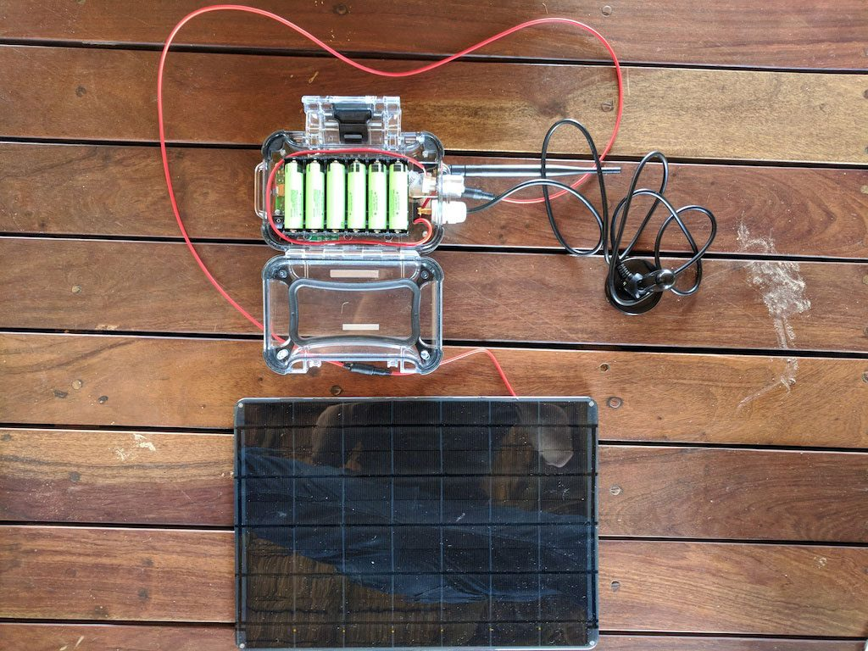
Artificial Intelligence is providing a new angle for studying wildlife
Detecting Poachers
Hack the Planet
Their system consists of a camera trap wirelessly connected to a mini-computer
The mini-computer downloads the camera’s images and then uses AI to classify whether there’s a wild animal or human in the photo
The computer then uses a satellite modem to send a warning directly to the rangers’ phones so they can have updates in real-time
Previously the camera trap’s media had to be checked by a ranger, making it difficult to know what’s happening in real-time.
Sources: https://www.hack-the-planet.io
www.africanews.com

Slide 10
The downsides
Crowd aided machine learning could give away locations to poachers
Inaccurate data collection could have serious consequences, especially if things are missed
Non-invasive methods can’t collect the same detail of biological data

Slide 11
Thankyou!

